Slide 1
High-Resolution Carbon Monitoring and Modeling in Maryland
NASA CMS Phase II A 2012 - 2014
R. Dubayah, G. Hurtt, A. Swatantran, M. Zhao, L. Duncanson,W. Huang | University of Maryland
Richard Birdsey, Kris Johnson | U.S. Forest Service
Andrew Finley | University of Michigan
Jarlath O’Neill-Dunne | University of Vermont
Phil DeCola | Sigma Space Corporation
DEPARTMENT of GEOGRAPHICAL SCIENCES
NASA CMS Grant: NNX12AN07G
Notes:
Introduce

Slide 2
CMS Project Goal and Objectives
Estimating Carbon stocks for Maryland (30 m)
Validation of national biomass maps using FIA data and high resolution biomass maps
Sequestration potential using prognostic ecosystem model (ED) (90 m)
Demonstration of single photon lidar for rapid, large area carbon assessment
Framework for local-scale, high-resolution carbon stocks and future carbon sequestration using remote sensing and ecosystem modeling

Slide 3

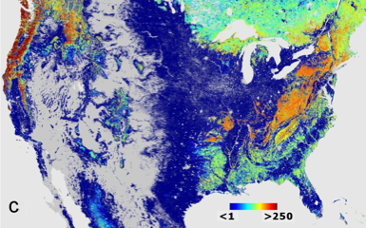
Methodological Approach
Field Data Collection and Analysis
Field Biomass Estimates
Allometry
Calibration
Validation
Small-Footprint Lidar
Algorithm Development & Image Processing
Machine Learning and Statistical Models
High Resolution Biomass Estimation
Error Analysis
High-Resolution Imagery (NAIP)
Validation
Biomass
Prognostic Ecosystem Modeling
Carbon Flux
Sequestration Potential
National Mapping
Notes:
Methods

Slide 4
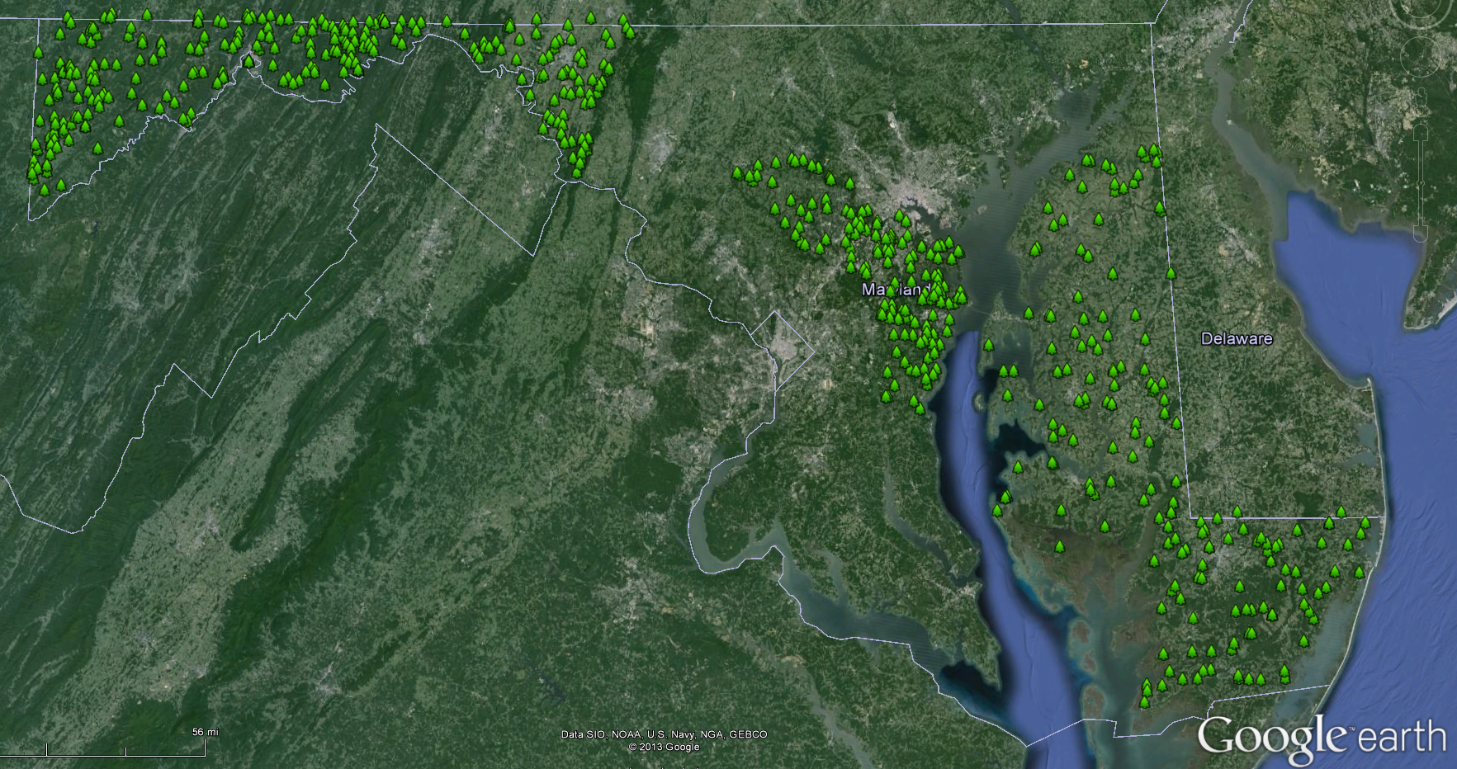
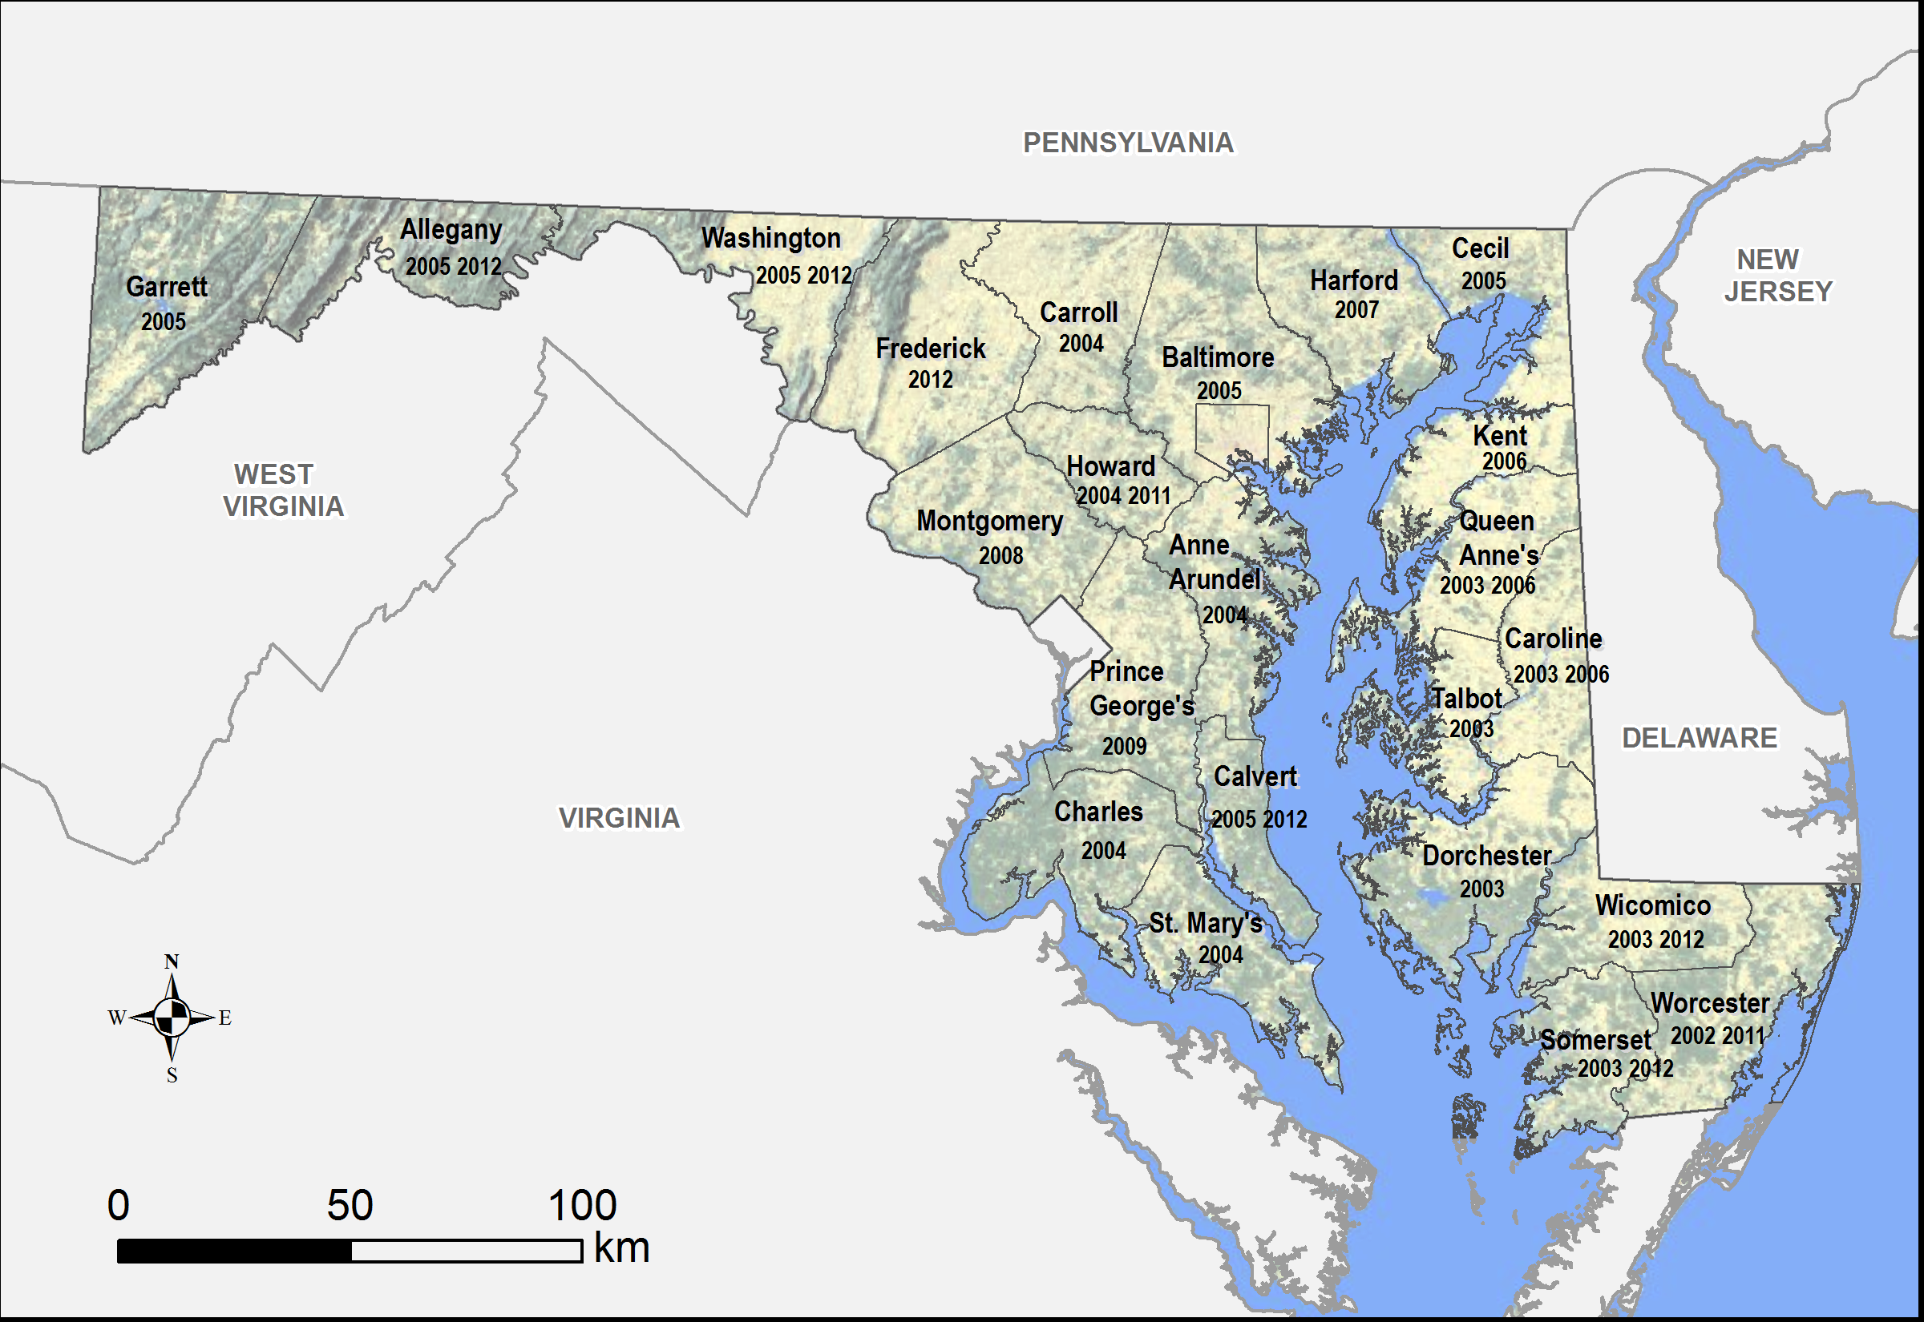
Field and Lidar Data
Plot Data
Stratified sample
NLCD strata
Lidar height classes
~ 800 variable radius plots
Forest Inventory and Analysis (FIA) plots
Lidar Data
Leaf-off
~ 1 pt/m²
Multiple coverages
Huge processing effort
32,000 km²
(3.2 x 10⁶ ha)

Slide 5
Lidar Canopy Height [1 m]

Slide 6
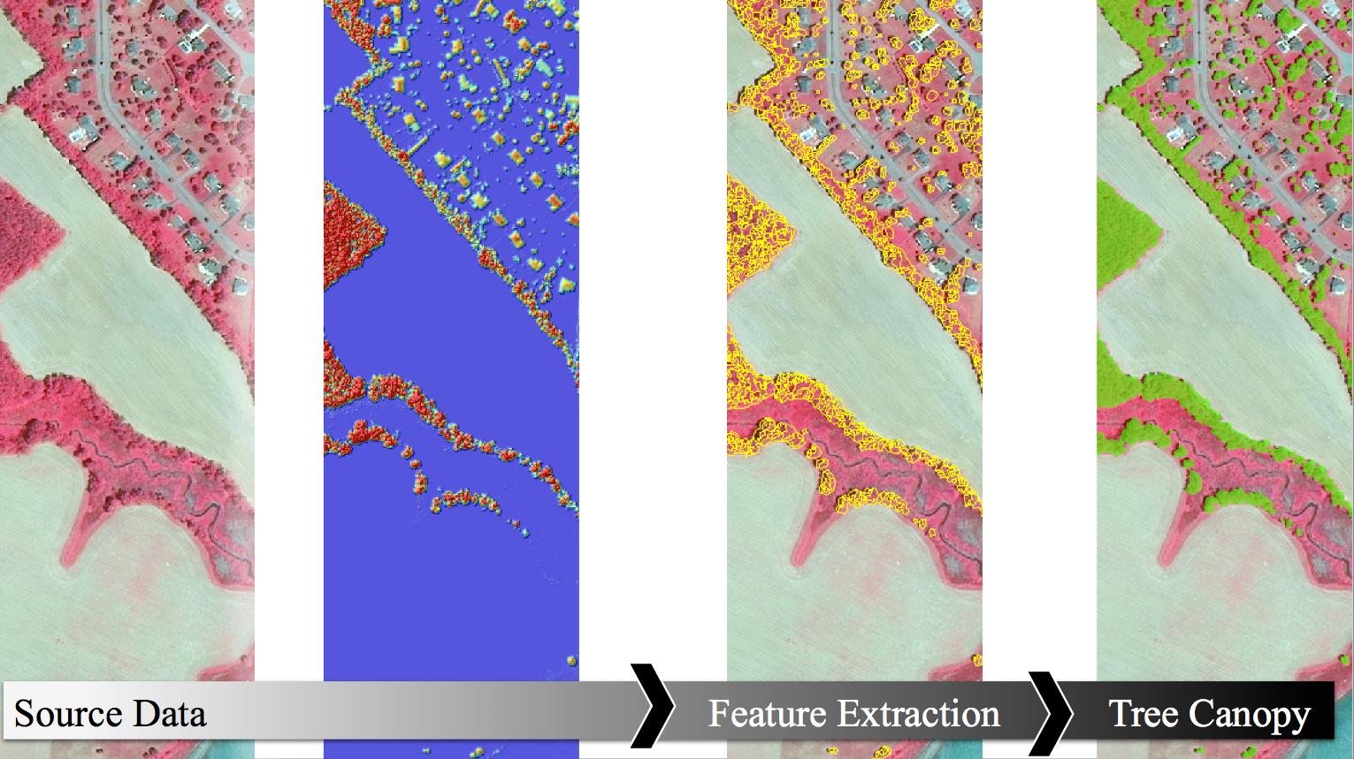
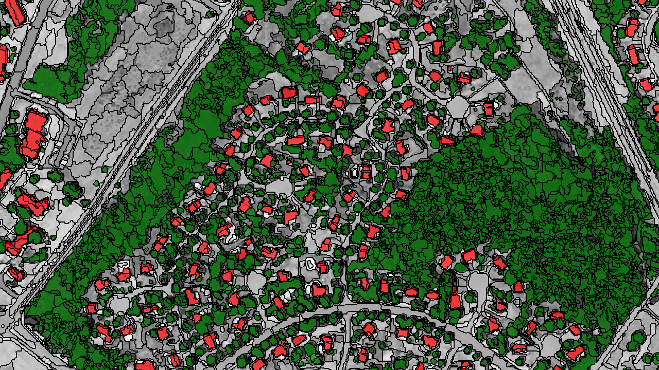
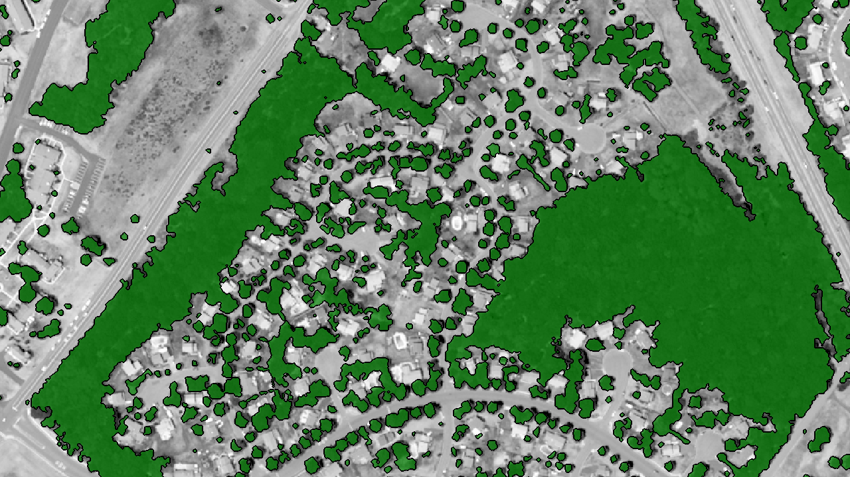
Canopy Cover Generation
NAIP
Lidar
Segmentation
32 billion land cover pixels

Slide 7
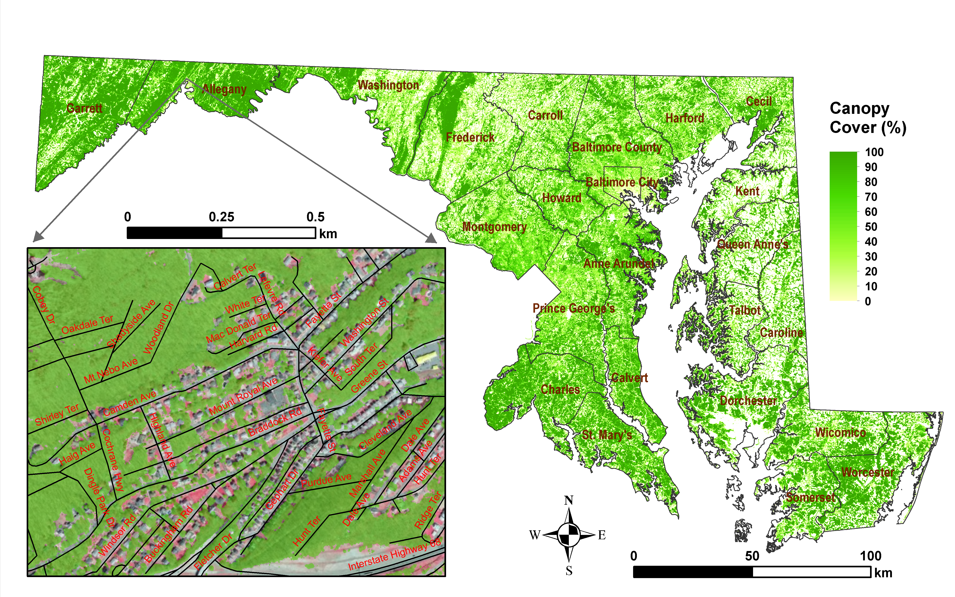
Tree Canopy Cover [1 m]

Slide 8
Statistical Methods for Biomass
Explored various methods
Regression-tree performed best
  “RandomForest” (for biomass mapping)
  Quantile regression forests (for error mapping)

Slide 9
Empirical Biomass [30 m]

Slide 10
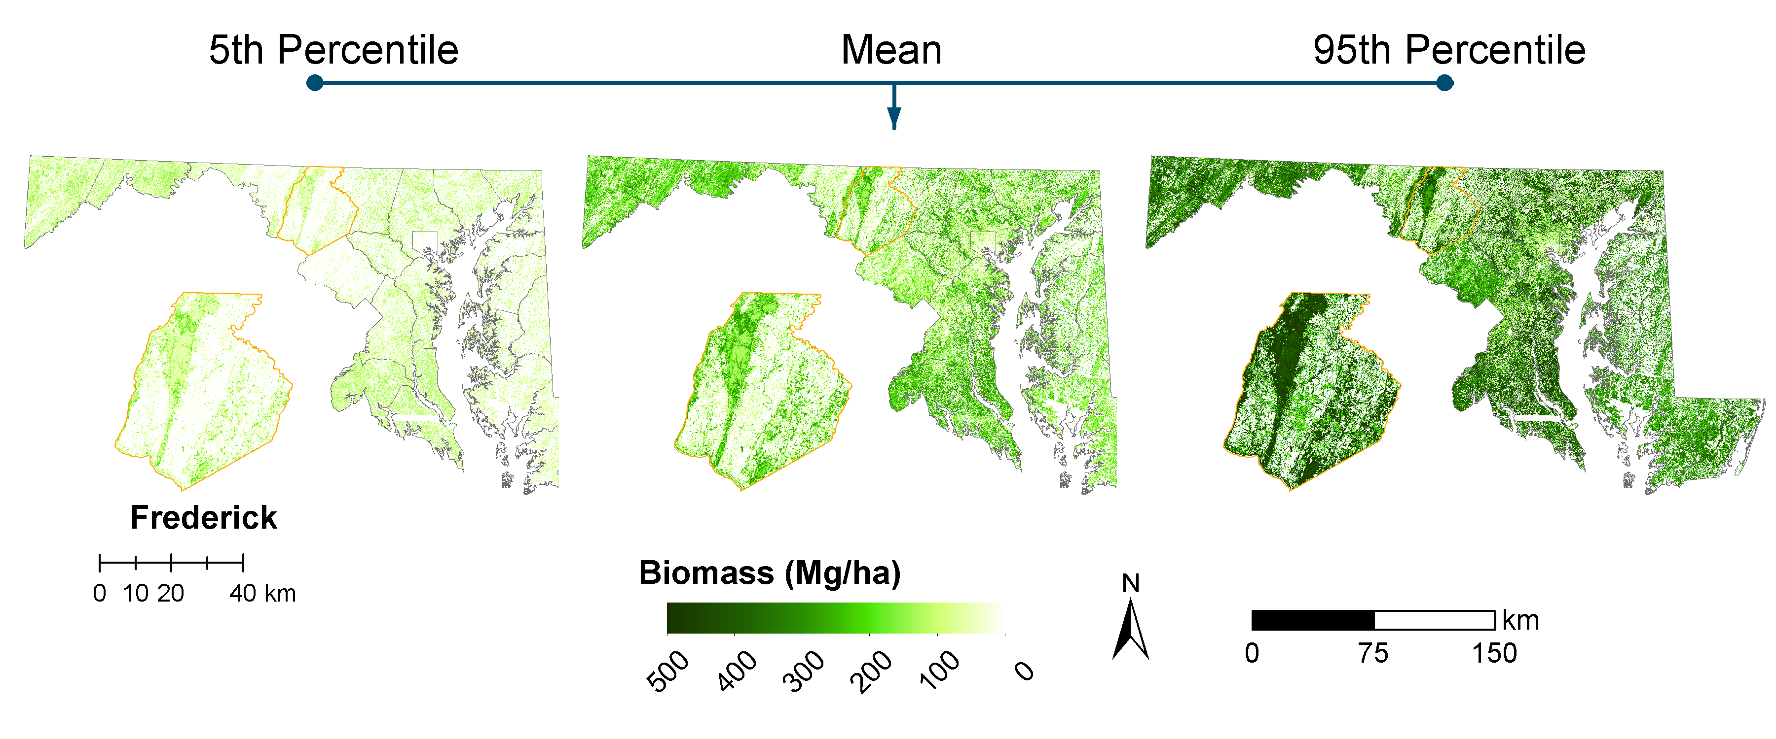
Pixel-level Biomass Uncertainty
Quantile regression trees to predict range

Slide 11
Validation With FIA Data
Plot Level
County Level
R² = 0.71
RMSE = 46.3 Mg/ha
R² = 0.78
RMSE = 2.2 Tg

Slide 12
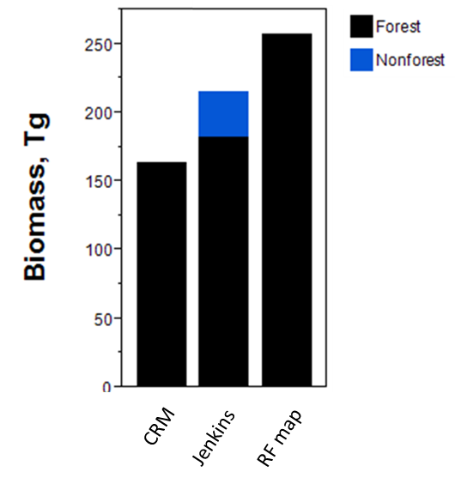
Validation With FIA Data
State Level
13% difference after adjusting for allometry and non-forest areas
-36% Difference
+7% Jenkins Adj.
+16% Non-forest Adj.
FIA
FIA*
CMS

Slide 13
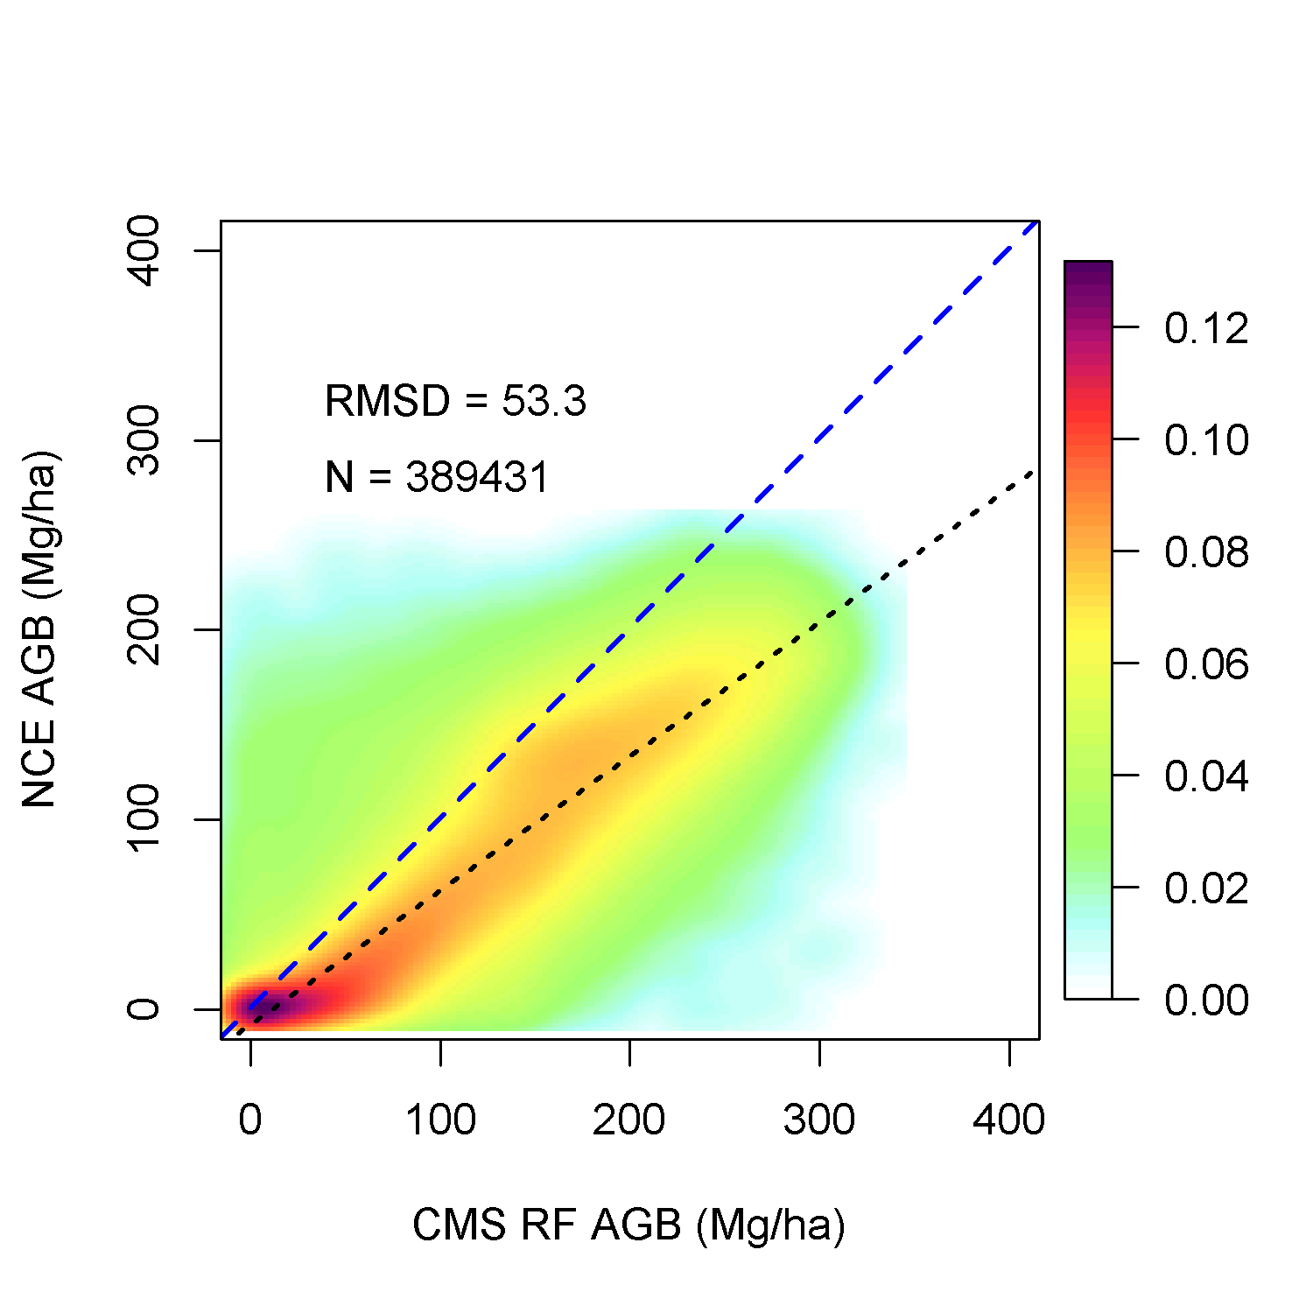
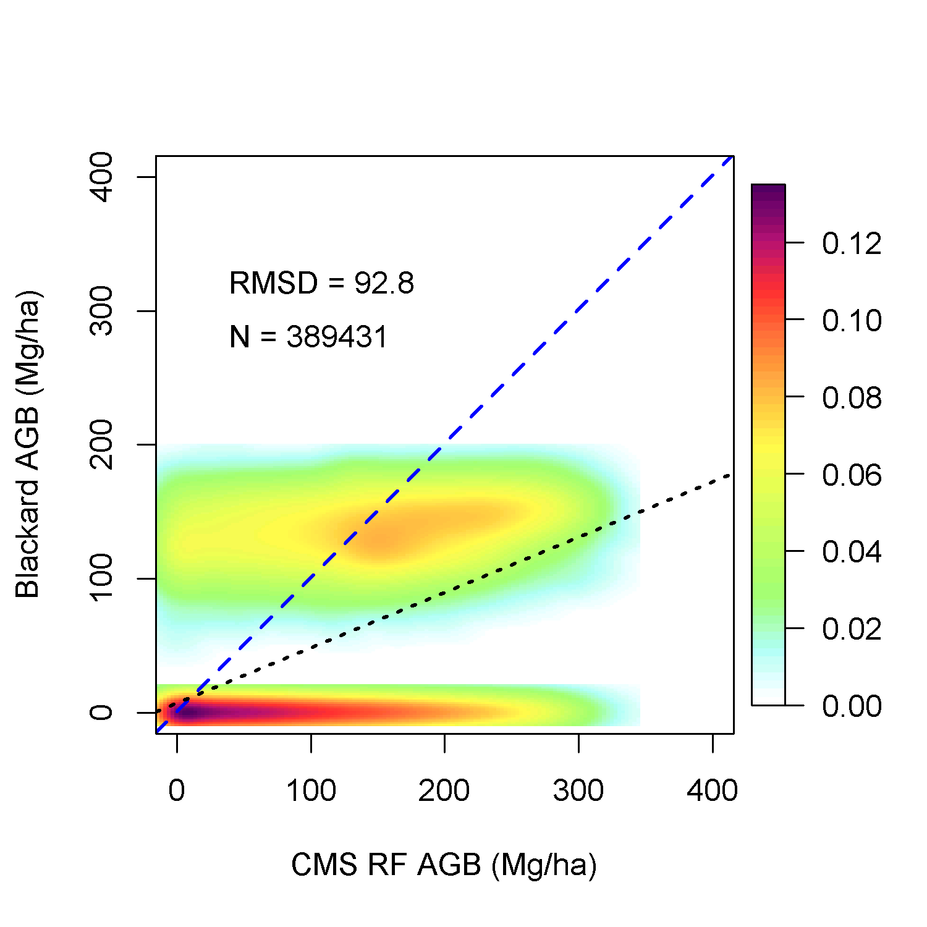
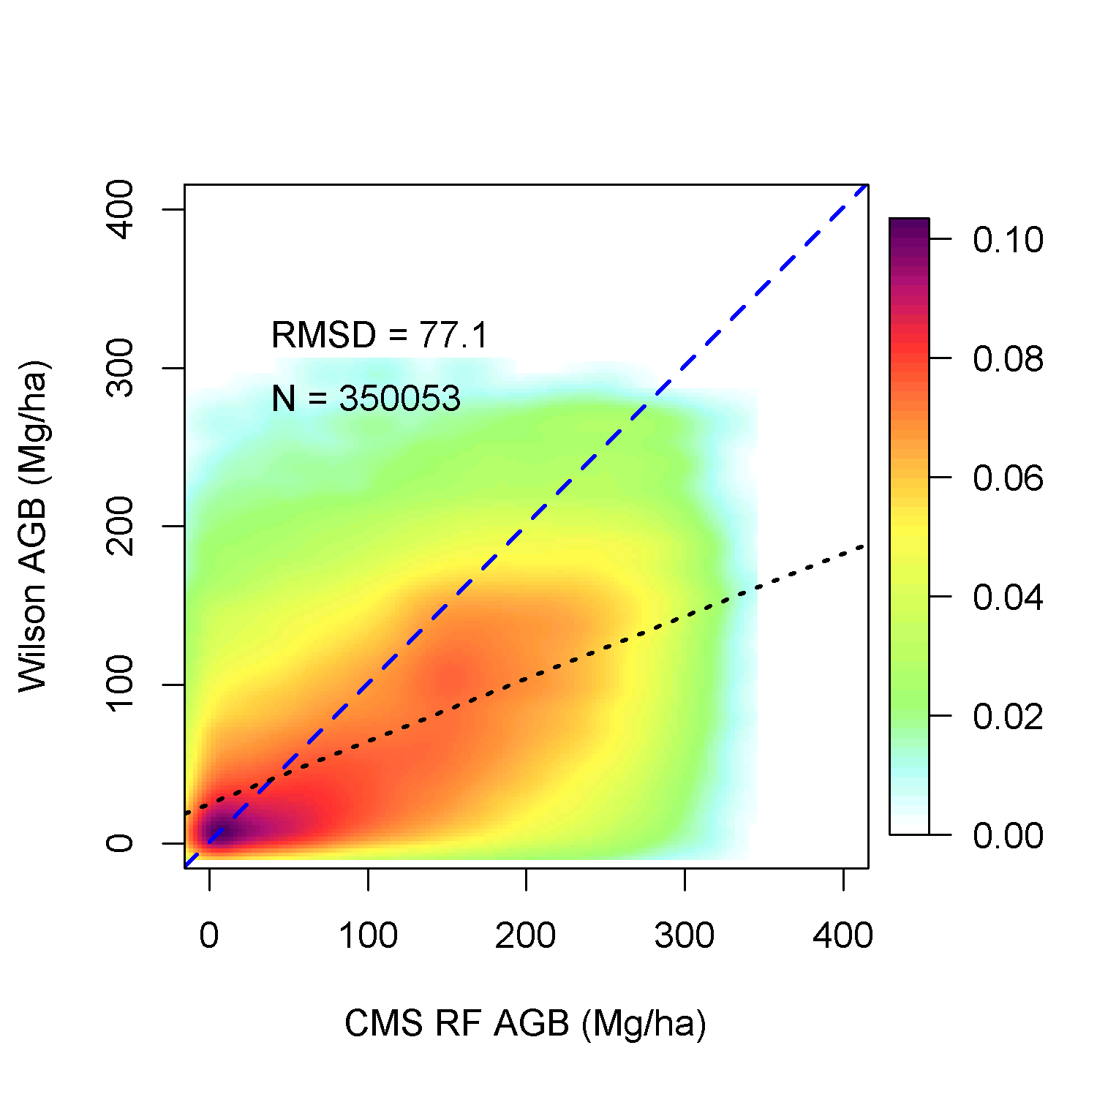
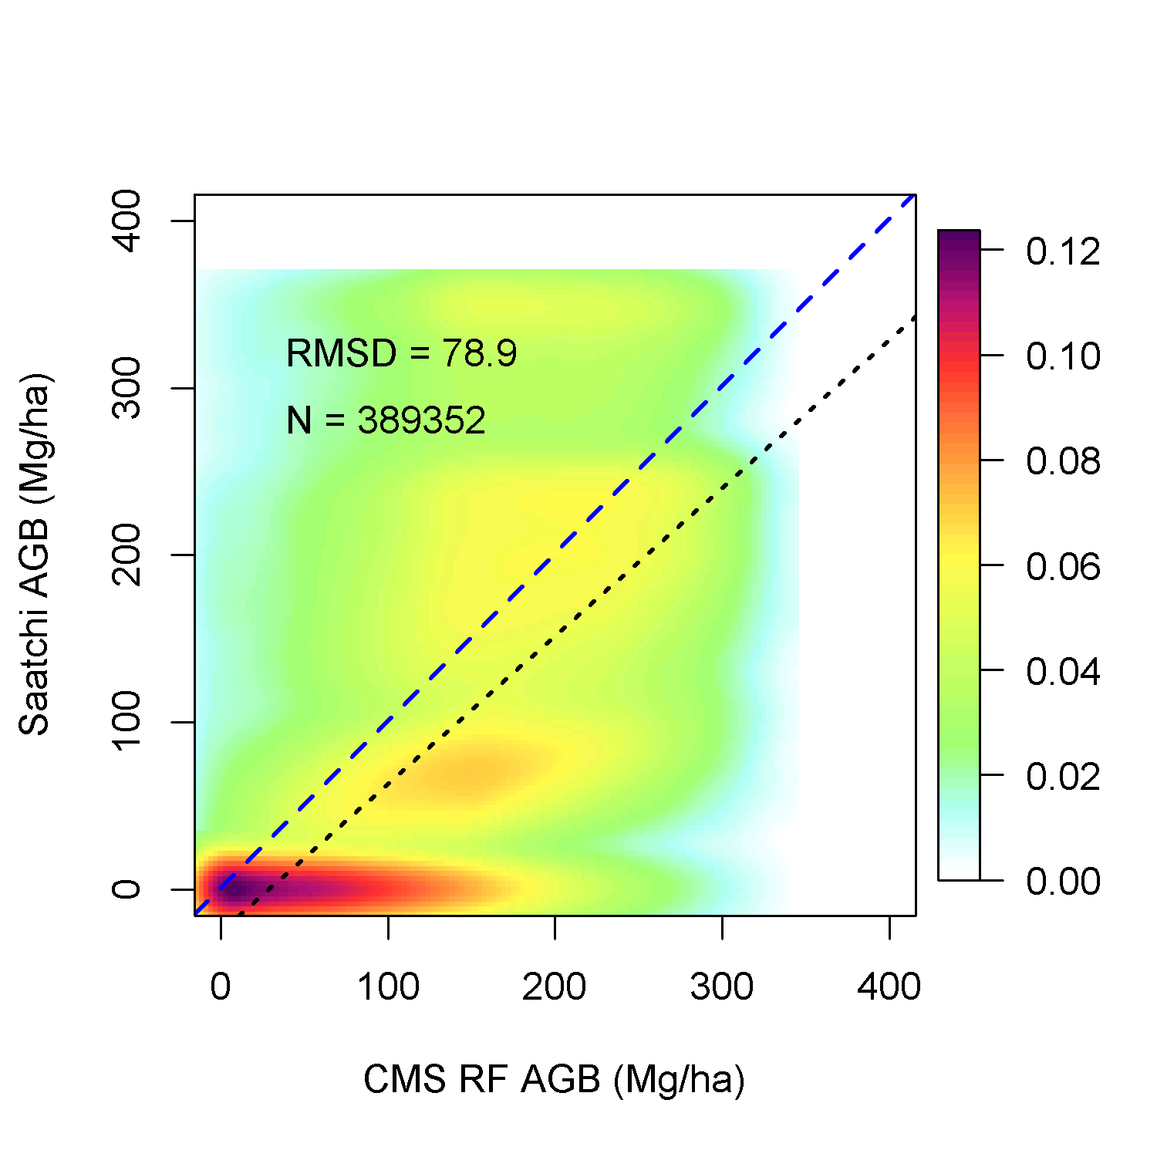
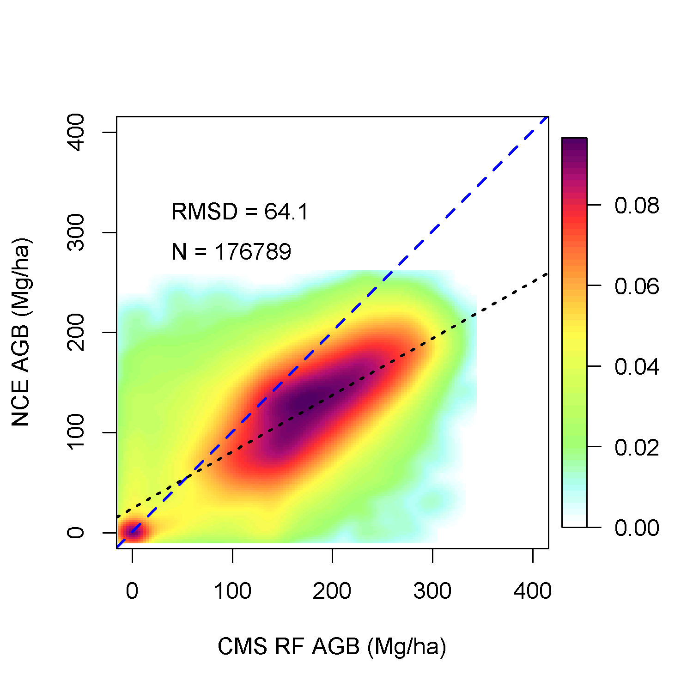
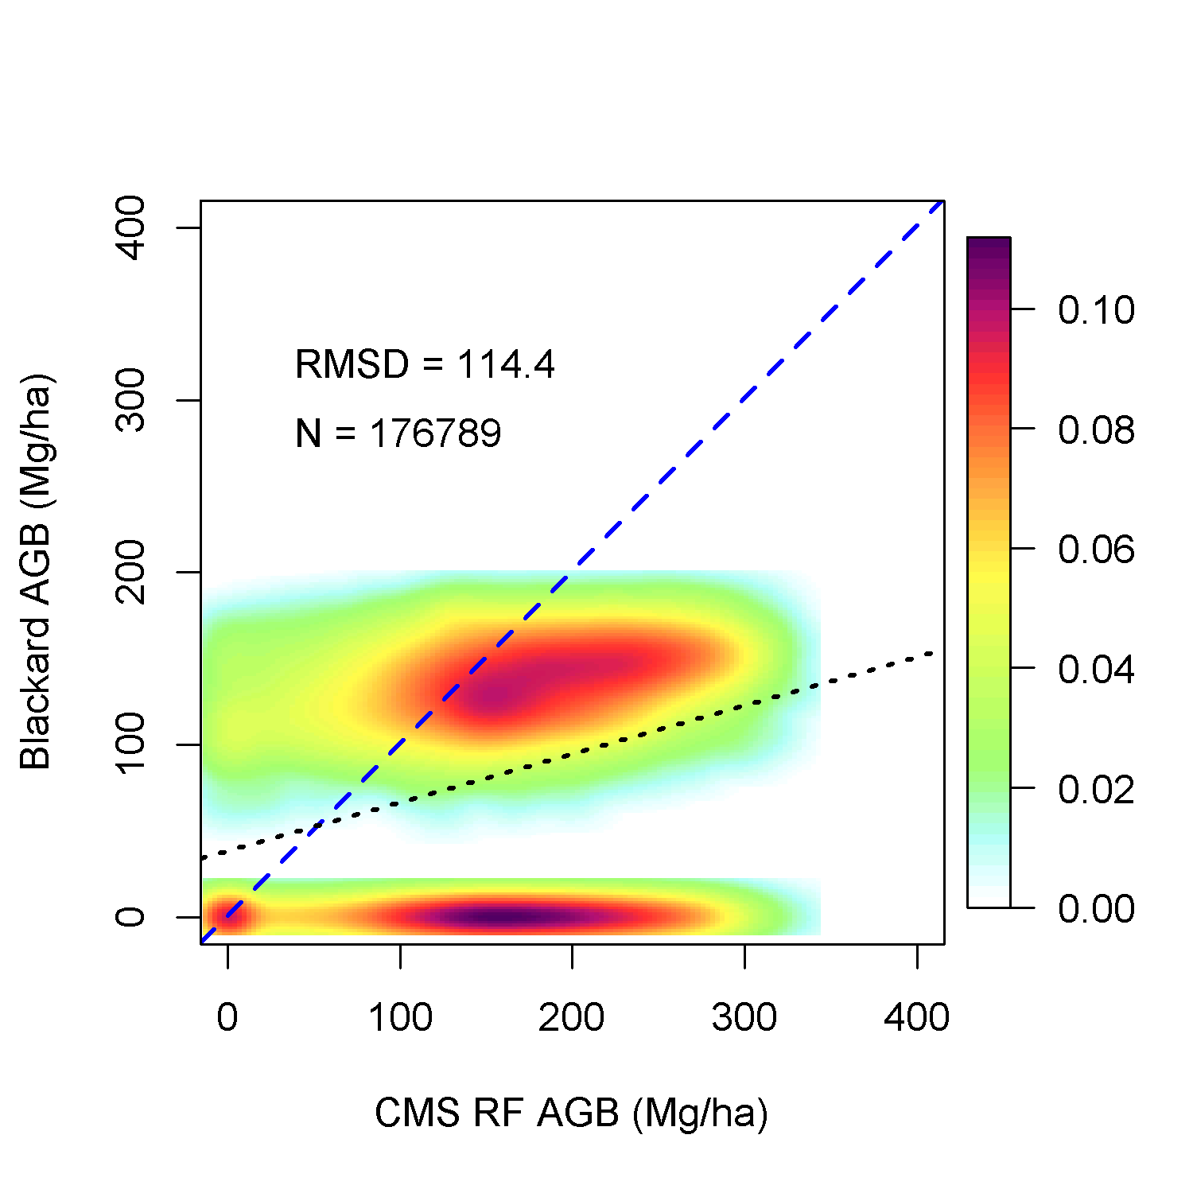
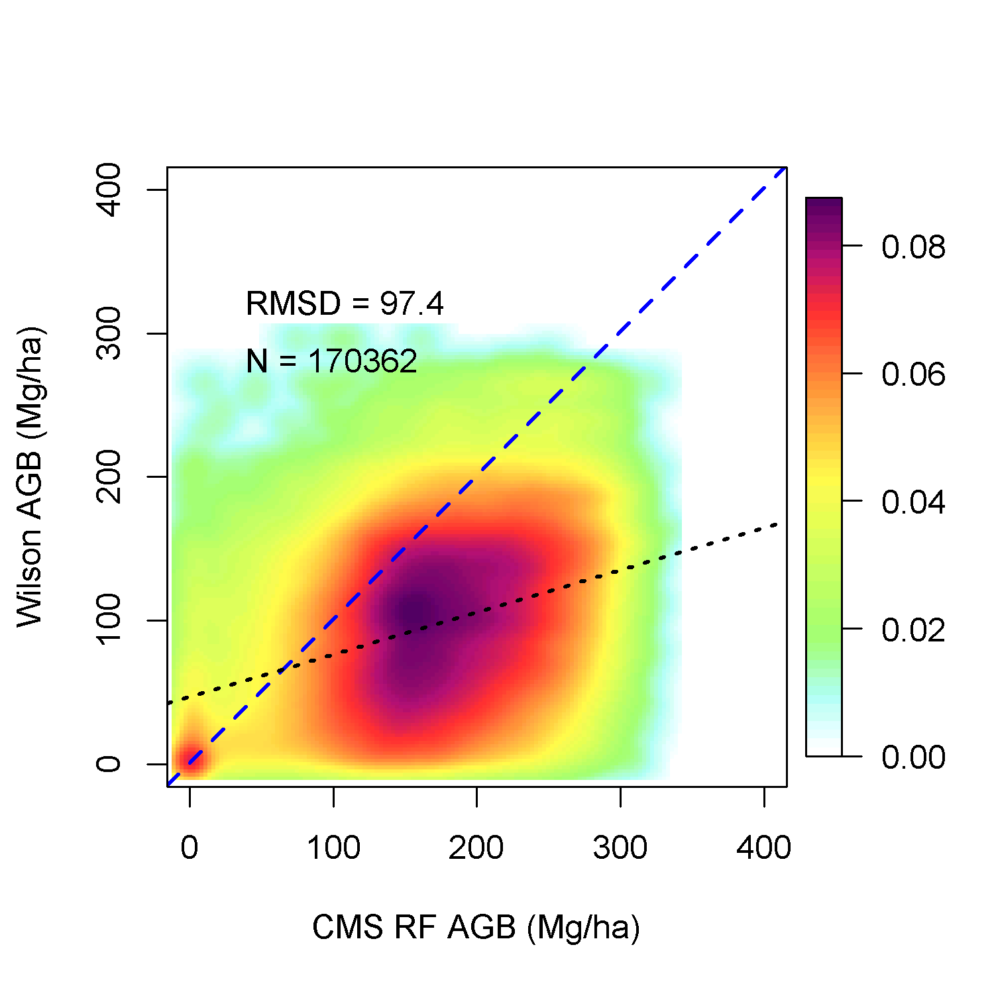
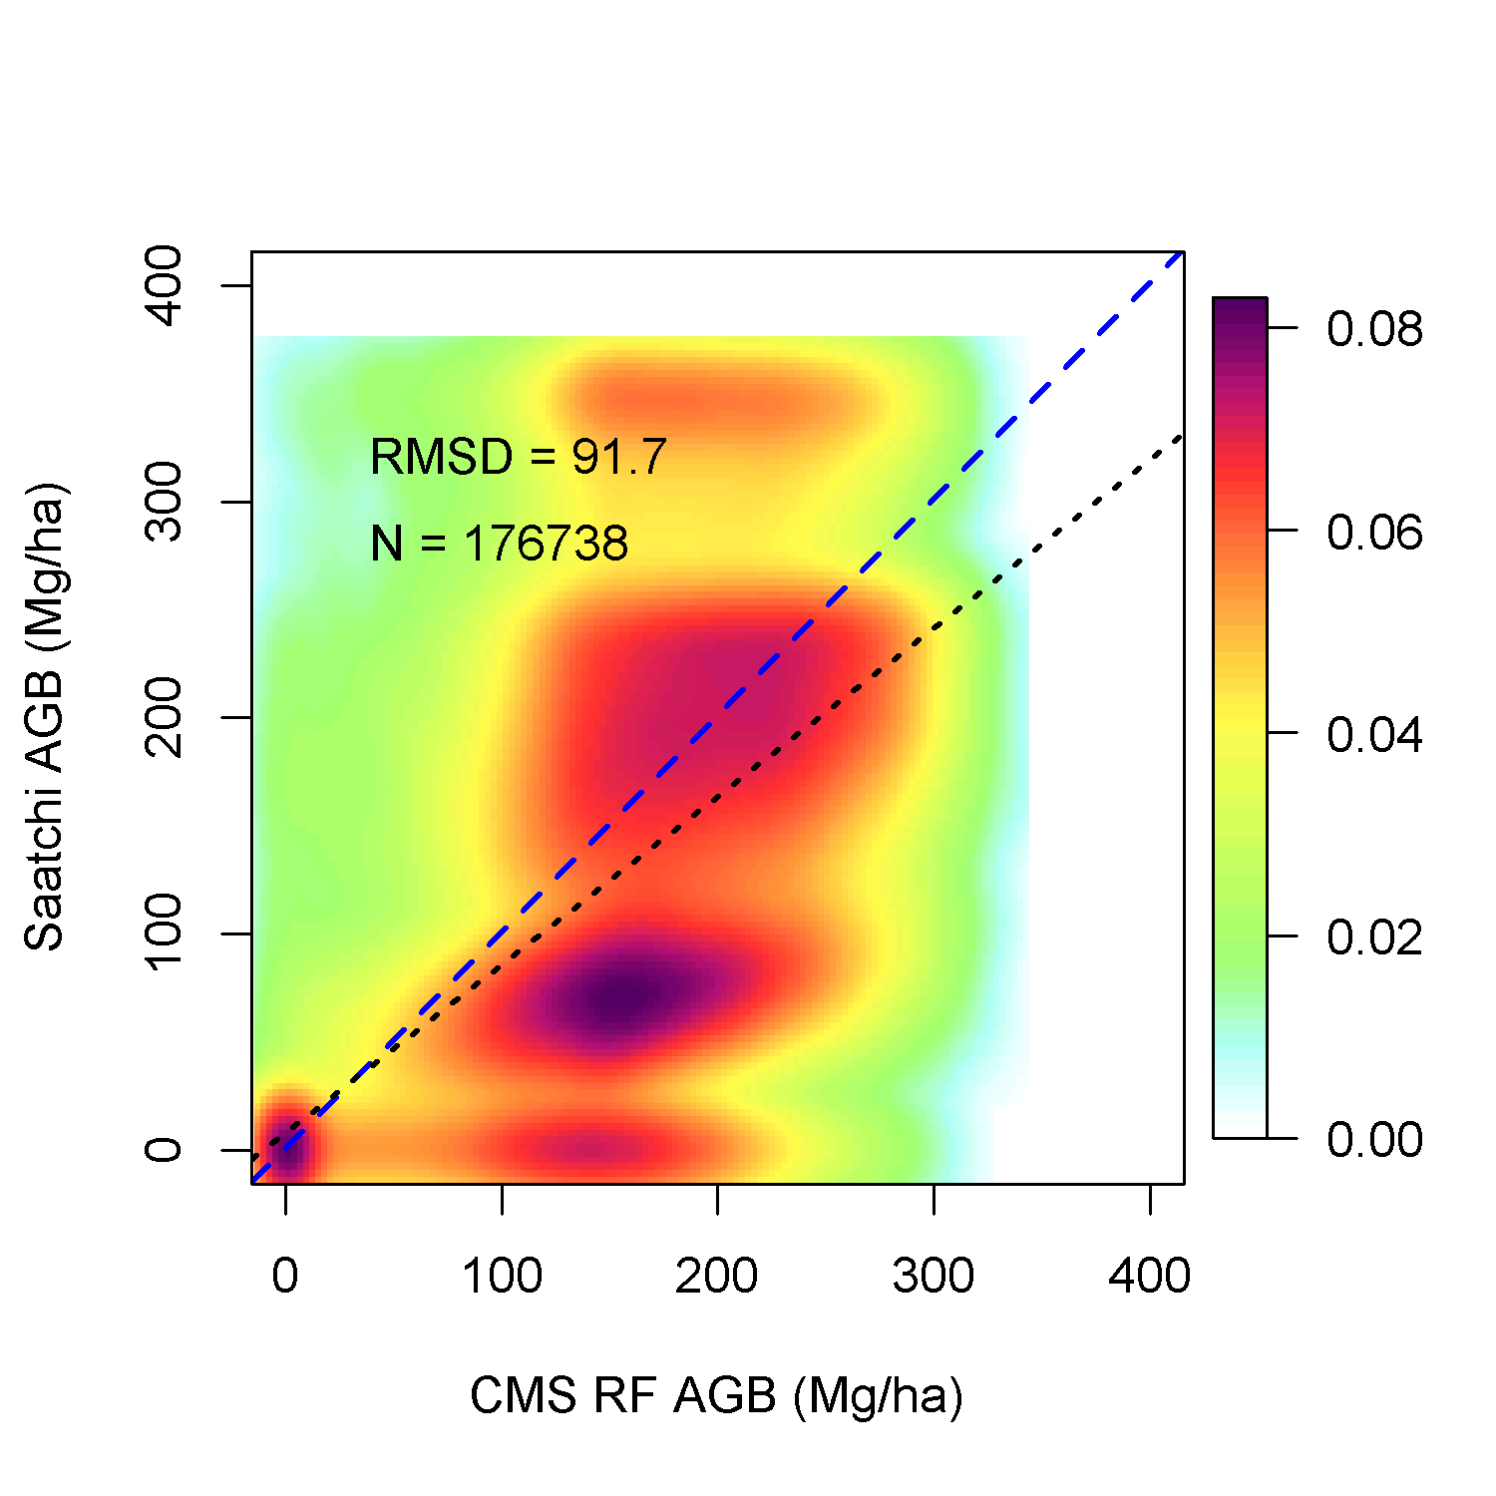
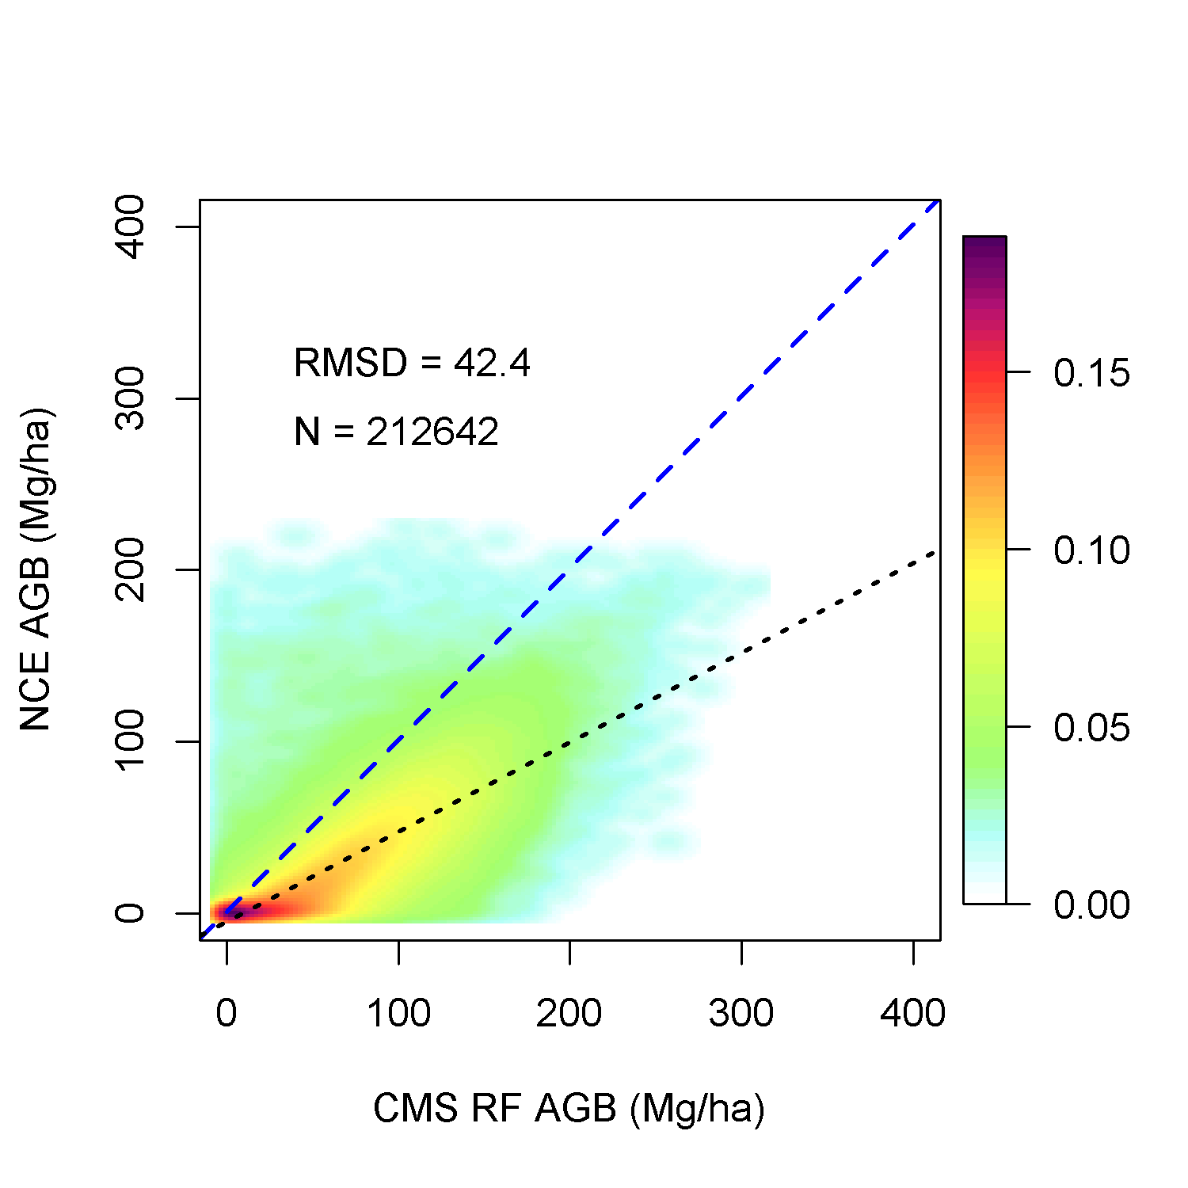
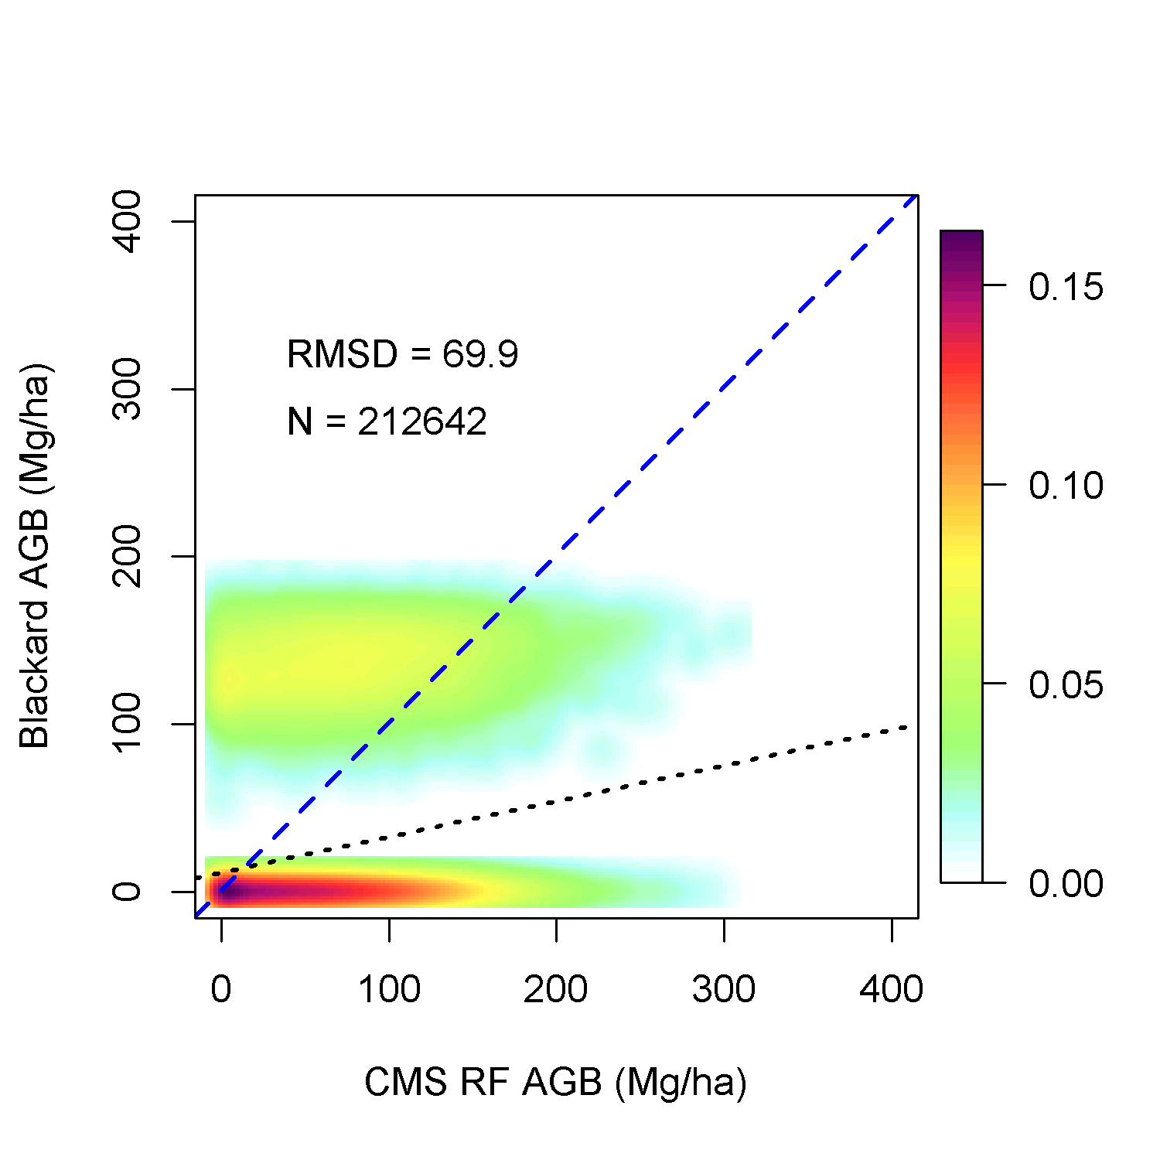
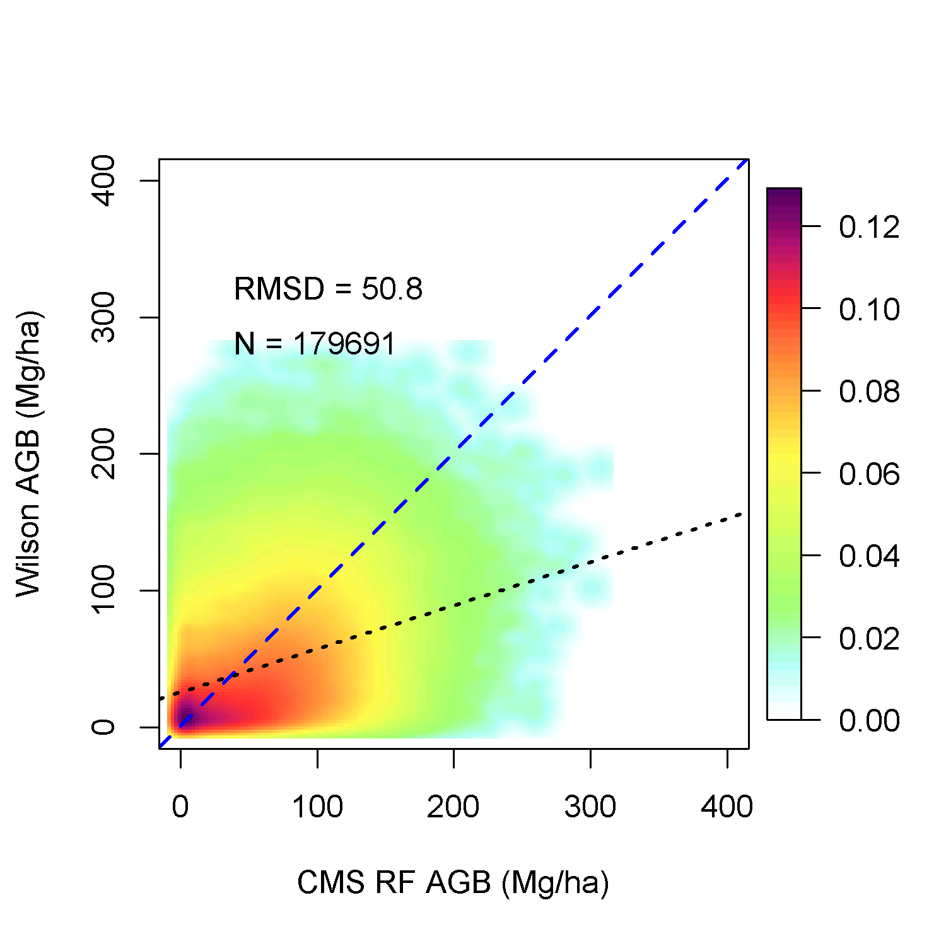
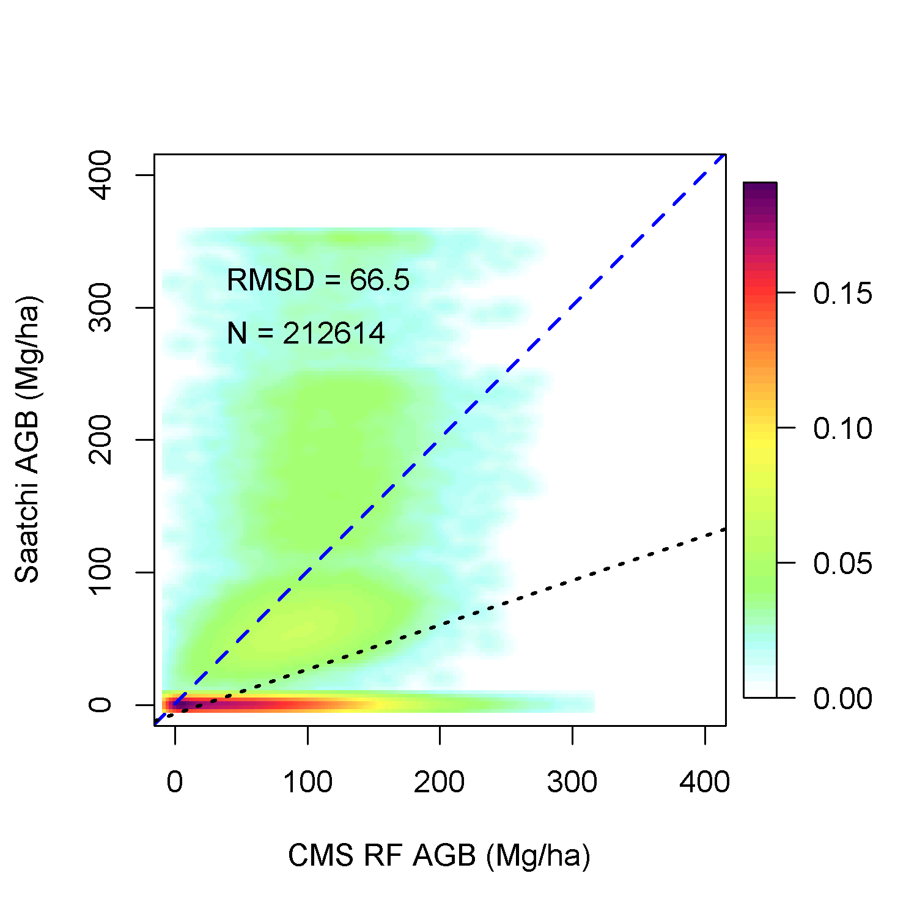
Comparison to National Maps
NBCD
Blackard
Wilson
Saatchi
Total
Forest
Non-forest

Slide 14
Prognostic Ecosystem Modeling
Height-structured ecosystem model
Initialized with lidar height data
Ecosystem
Demography
Model
(ED)
Climate & Soils

Slide 15
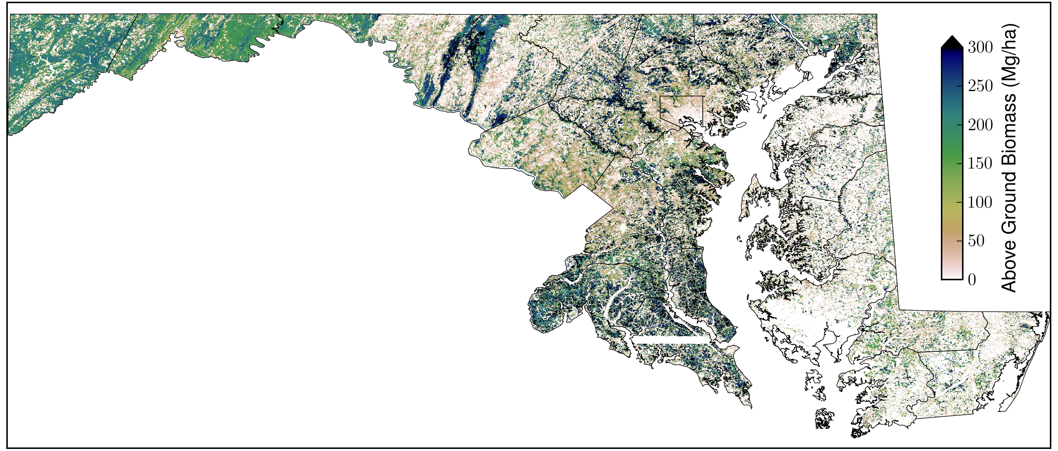
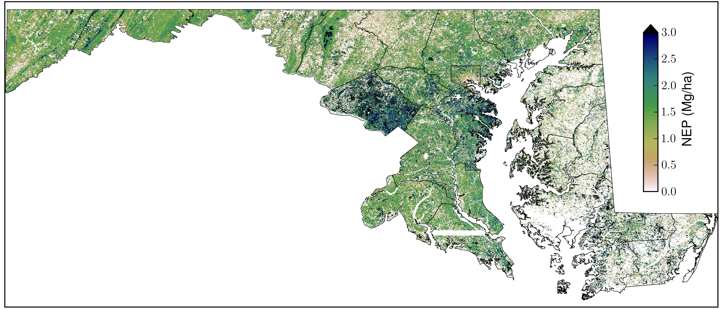
Forest AGB and NEP from ED
Aboveground Biomass
AGB = 110.12 Tg C
Mean = 103.23 Mg/ha
Net ecosystem productivity
NEP =1.34 Tg C/yr
Mean = 1.26 Mg/ha/yr.

Slide 16
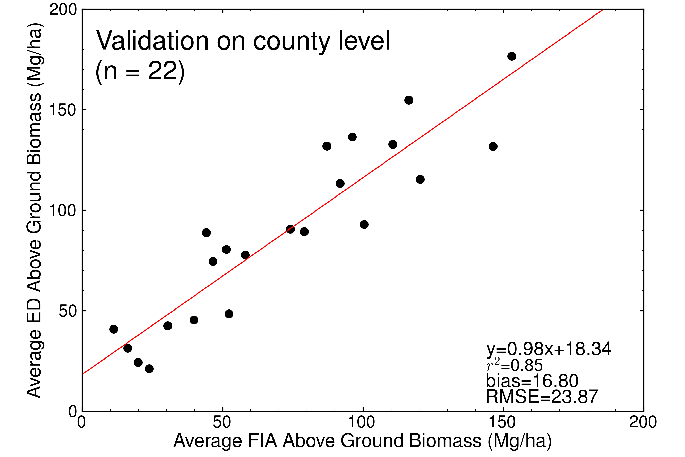
Validation With FIA County Averages

Slide 17
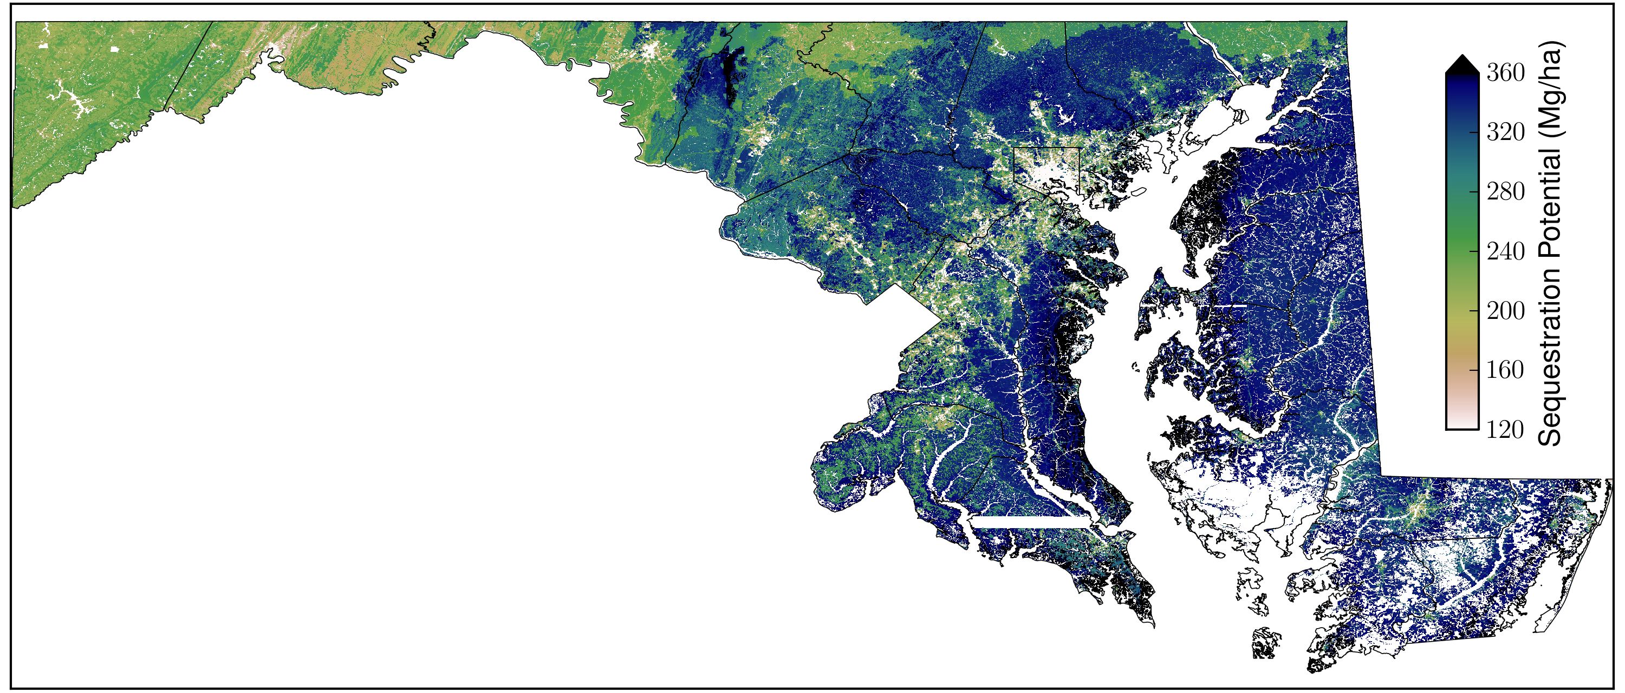
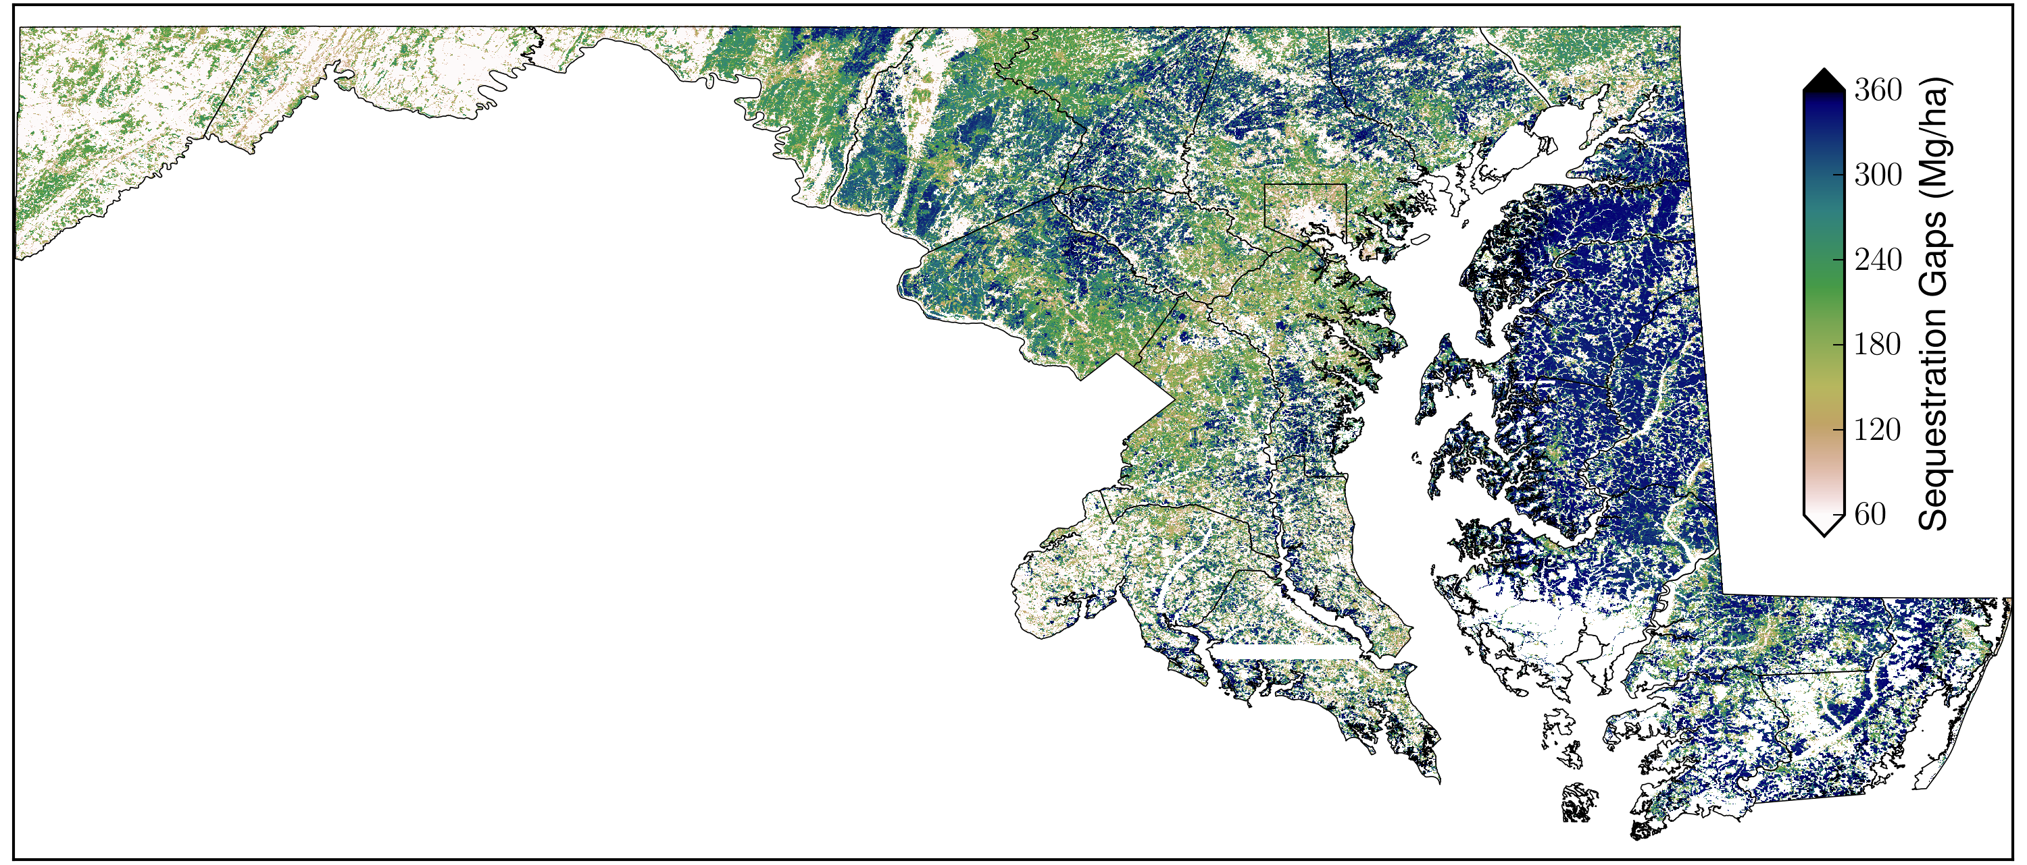
Carbon Sequestration Potential and Gap
Sequestration Potential =
314 TgC
Mean = 294 Mg/ha
Sequestration gap = 204 TgC
Mean = 191 Mg/ha

Slide 18
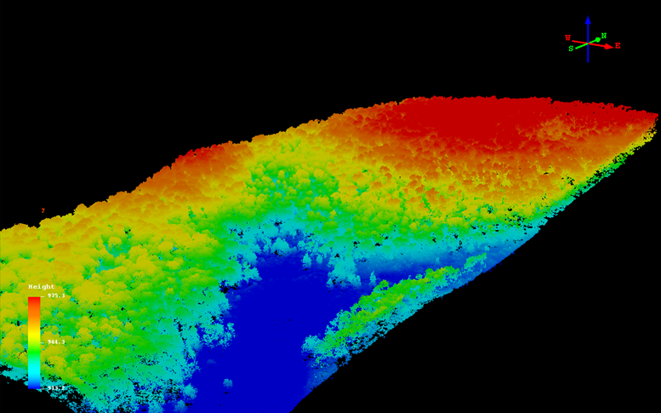
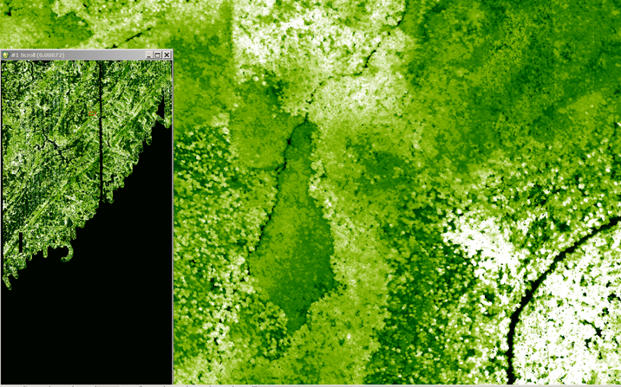
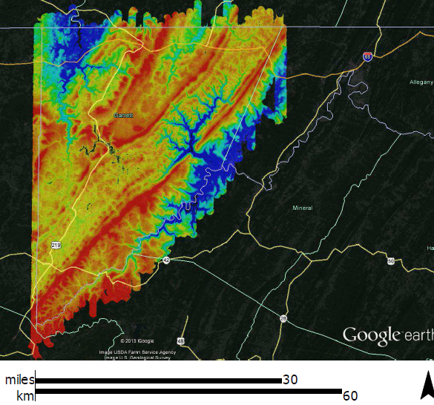
Single Photon Lidar
HRQLS – High Resolution Quantum Lidar System
  100 beam system (532 nm – visible green)
  Flew Garrett County (1700 km² – 170,000 ha) in 12 hours
Canopy Height Model [1m]
Denoised SPL point cloud

Slide 19
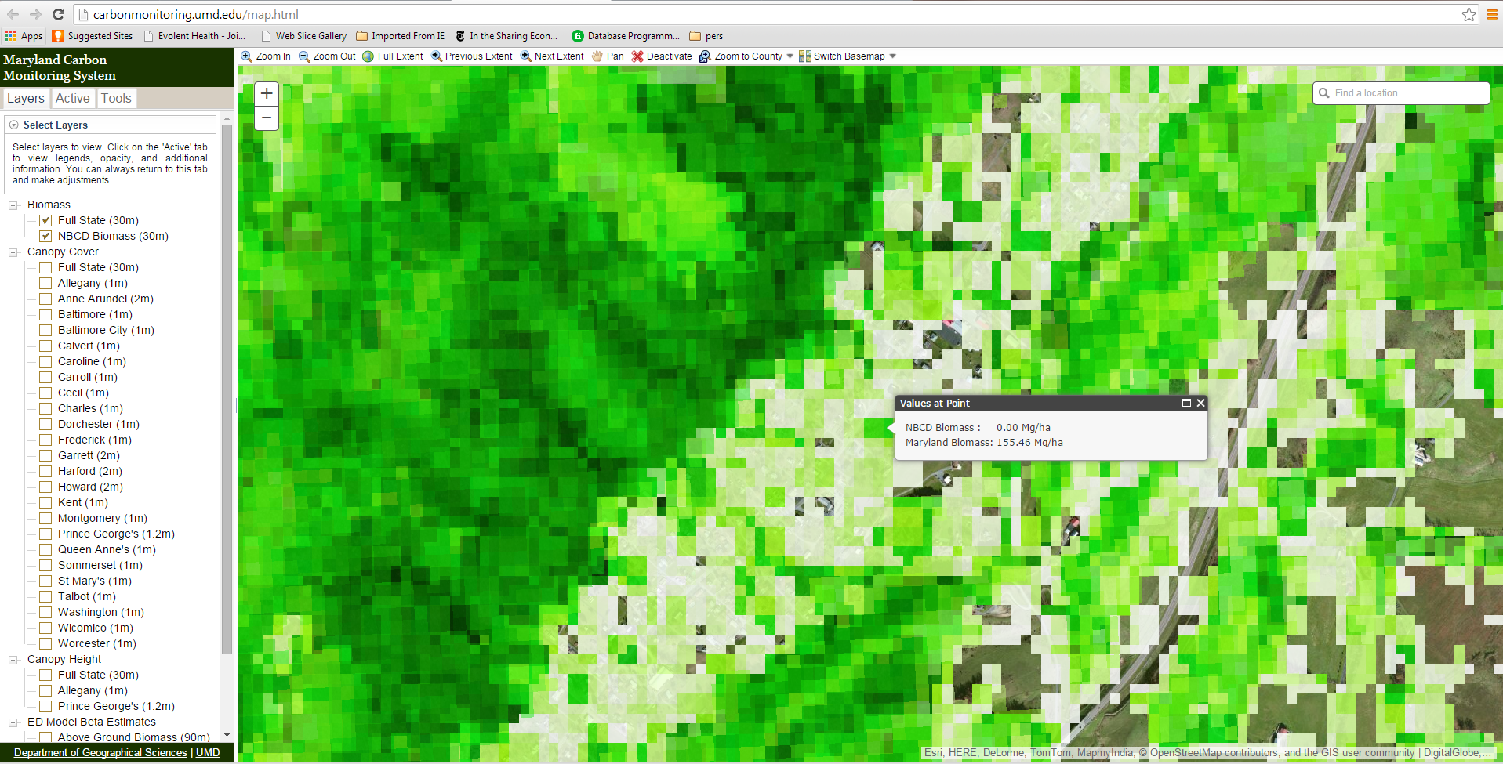
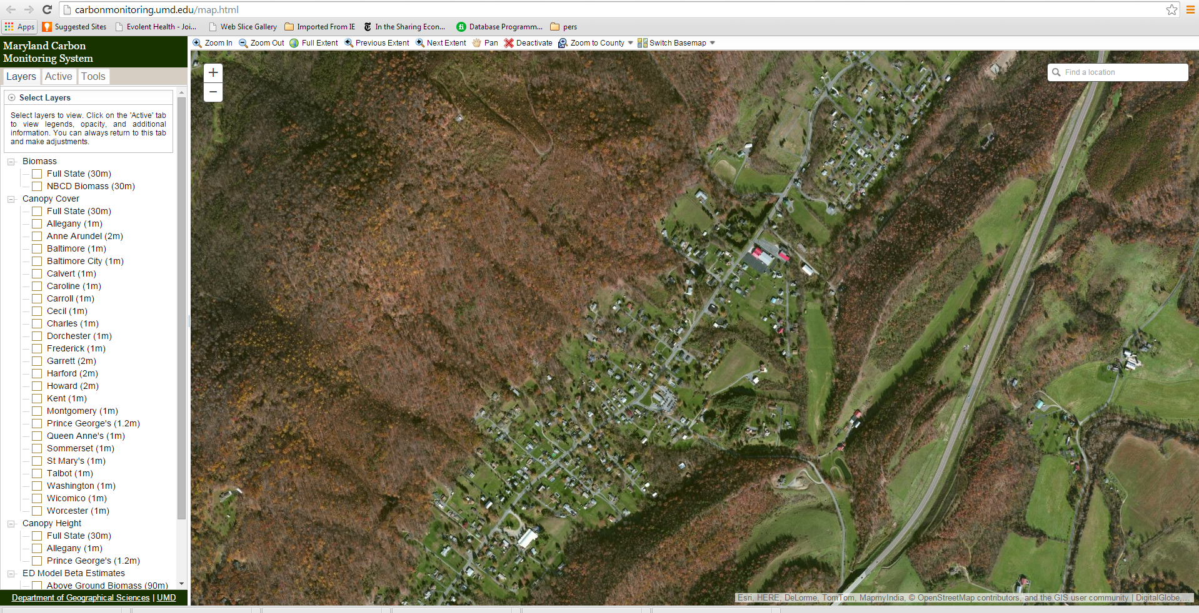
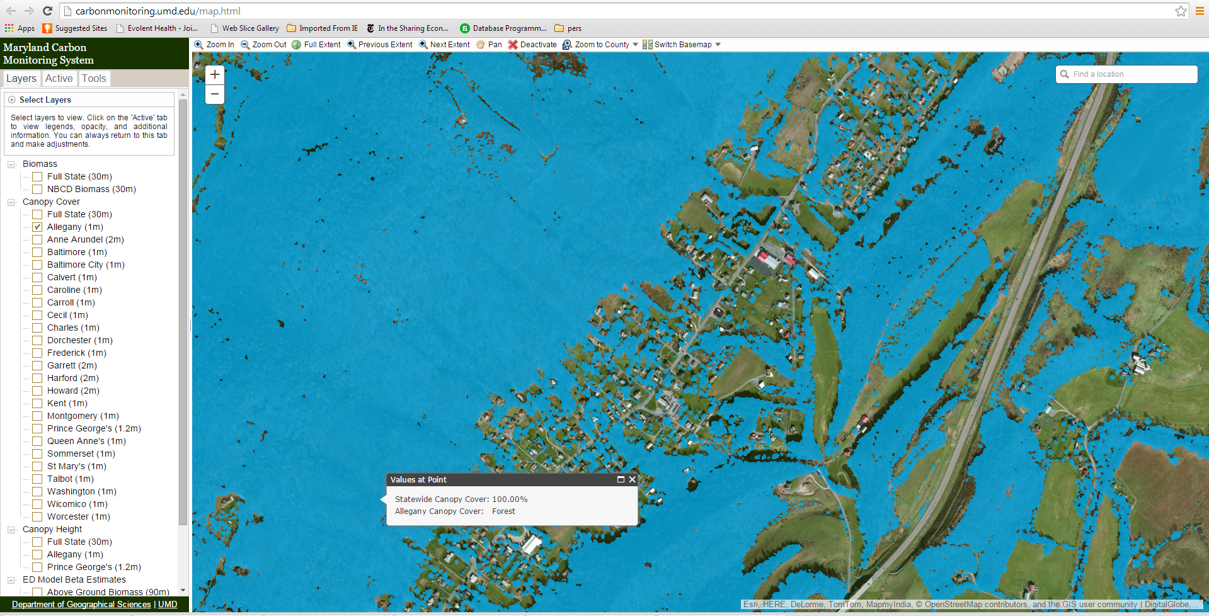
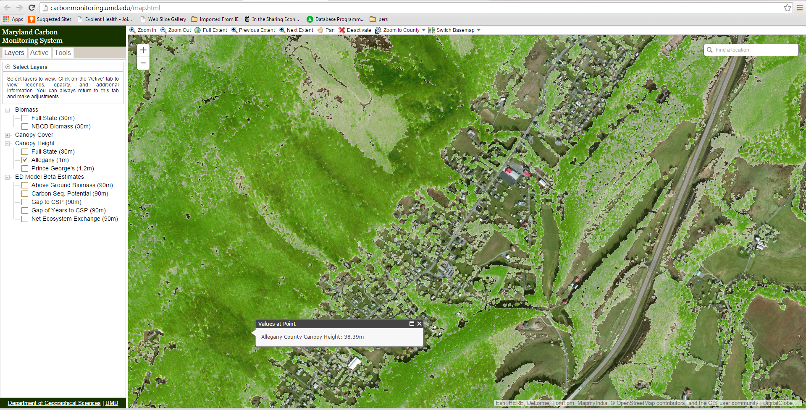
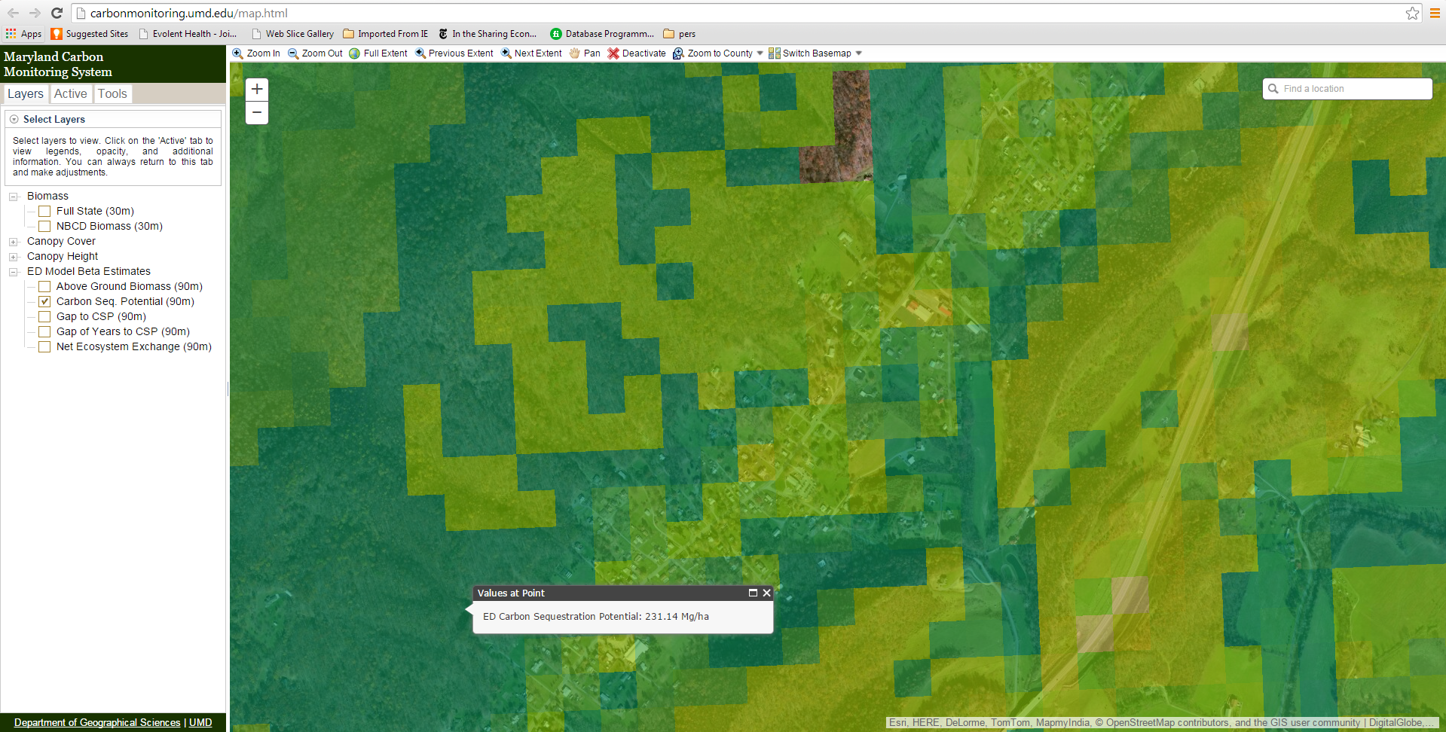
Web-based Maryland Carbon Monitoring System

Slide 20
Conclusions
State-wide, high-resolution mapping and modeling of carbon stocks and fluxes feasible
  Errors large at fine scales (30 m)
National maps are in large disagreement at fine scales
Ecosystem modeling powerful carbon policy tool
Single photon lidar provides efficient mapping

Slide 21
www.carbonmonitoring.umd.edu
Local Scale CMS Framework provides scalable path to national mapping

